Slide 1
Predictive Analytics: Diabetes risk assessment
Via Machine Learning

Slide 2
Diabetes IN THE WORLD
589
MILLION
people have diabetes
1 out of 10
1 out of 5 doesn’t know

Slide 3
steps
01
02
03
04
Models used
Cleaning of the data
Model preparation
KNN
Logistic Regression
Decision Tree
Random Forest Hyperparameter Tuning
Replace negatives
Check for duplicates
Check for 0 values
EDA
Split the data in 80%
Normalize the data
Correlation Matrix
BOXPLOT Analysis

Slide 4
OUR DATASET
CONTAINS 9 COLUMNS AND 1000 ROWS
01
Pregnancies
06
Insulin
02
Glucose
07
BMI
03
Blood Pressure
08
Diabetes Pedigree Function
04
Skin Thickness
09
outcome
05
age

Slide 5
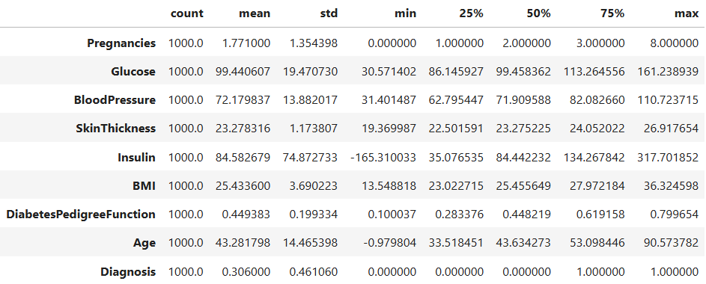
Descriptive statistics

Slide 6
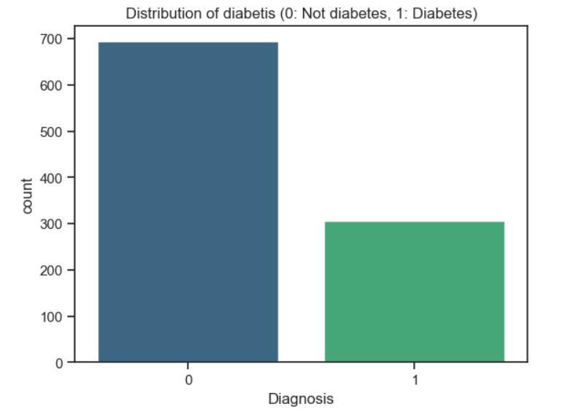
EXPLORATORY DATA ANALYSIS
The Imbalance Challenge
A critical challenge in medical datasets is the severe class imbalance. Most participants are non-diabetic, which can mislead models to prioritize total accuracy over clinical utility.

Slide 7
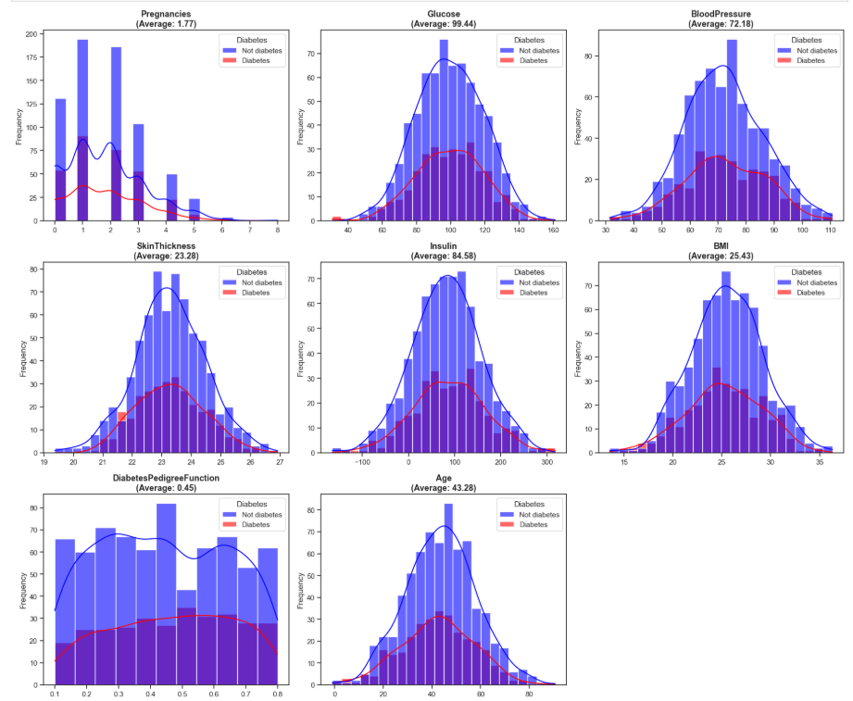
BOXPLOT analysis
Analysis of Insulin and Glucose levels reveals multimodal distributions, identifying clear clinical thresholds for risk.
BMI data shows a broad trend toward overweight/obesity, serving as a significant but non-exclusive predictor of metabolic distress.

Slide 8
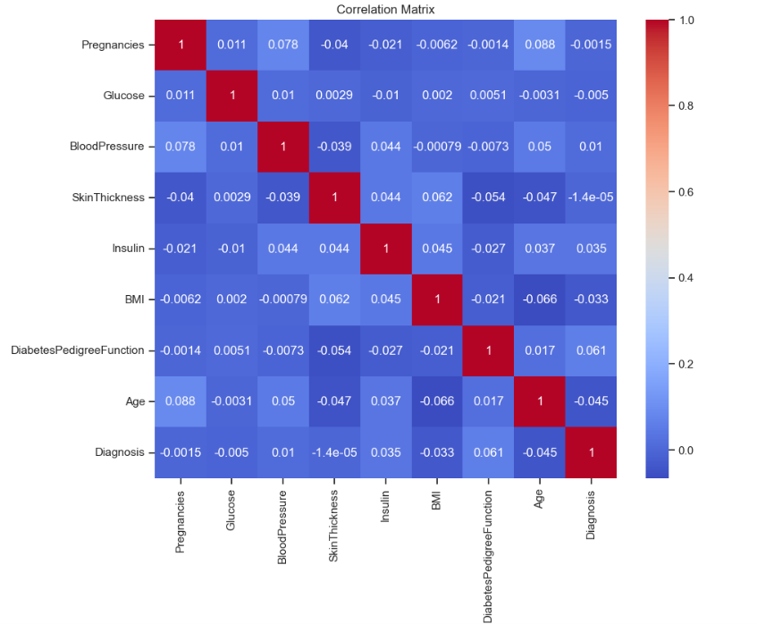
CORRELATION MATRIX
Correlation with the diagnosis:
Diagnosis : 1.000000
Diabetes Pedigree Function : 0.060549
Insulin: 0.041479
Blood Pressure: 0.010349
Skin Thickness: -0.000014
Pregnancies: -0.001484
Glucose: -0.004971
BMI: -0.033336
Age: -0.042510

Slide 9
MODEL evaluation
K-NN METHOD
Accuracy : 0.6200
The data show a high degree of overlap between classes in the multidimensional space, which makes it difficult to perform k-nearest-neighbor clustering

Slide 10
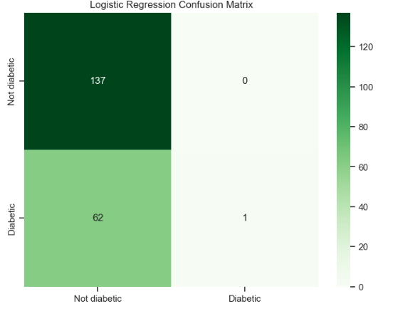
Logistic Regression
Accuracy: 0.6900
Precision: 1.0000
Recall: 0.0159
F1 Score: 0.0312
Although the accuracy is 69%, the recall analysis (0.0159) reveals that the model is ineffective for a medical setting, as it fails to detect 98% of patients with the disease.

Slide 11
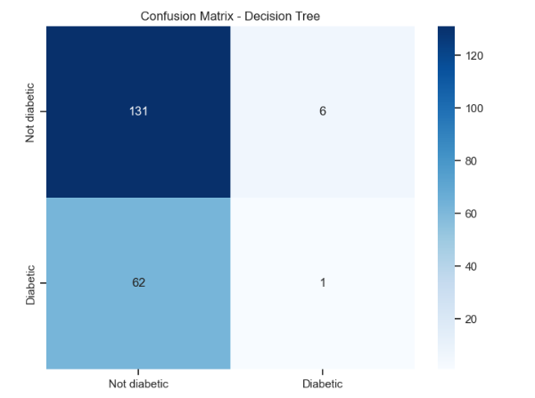
Decision Tree Classifier
Accuracy: 0.6600
Precision: 0.1429
Recall: 0.0159
F1 Score: 0.0286
The decision tree performed poorly in terms of precision (0.14) and F1-score. Not only did this model fail to detect most of the patients (recall of 0.01), but it also generated false alarms.

Slide 12
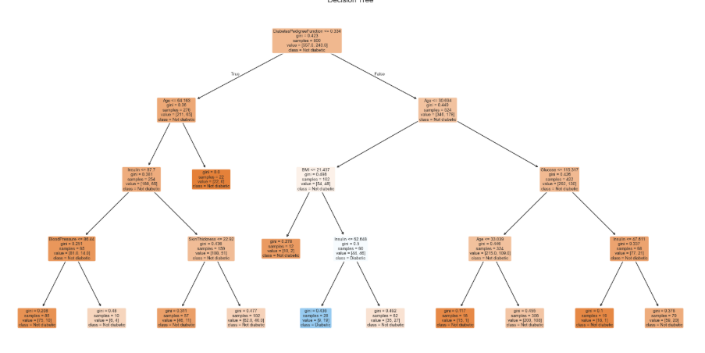
decision tree

Slide 13
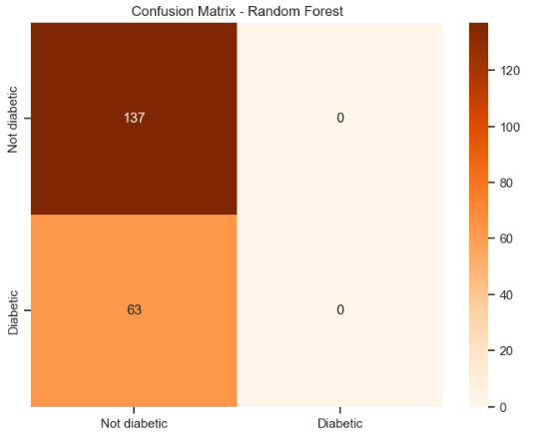
RANDOM FOREST
Accuracy: 0.6850
Precision: 0.0000
Recall: 0.0000
F1 Score: 0.0000
The Random Forest model completely failed to identify the minority class (patients with diabetes), resulting in a recall of 0.
Despite having an accuracy of 68.5%, the model is useless in medical practice.

Slide 14
Optimization WITH via GridSearchCV
Class Weight Balancing
Hyperparameter Tuning
Recall Shift
Penalizing errors on the minority class.
Optimized the 'C' regularization and penalty factors.
88% of real diabetic cases were successfully captured.

Slide 15
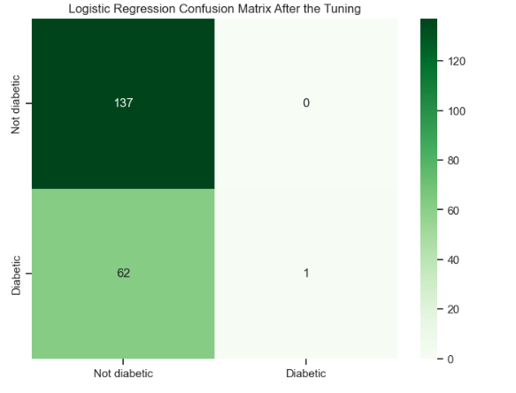
LOGISTIC rEGRESSION
Best training accuracy: 0.6962
We went from detecting virtually 0 patients to identifying 1,511, dramatically improving the model’s clinical utility.

Slide 16
CHALLENGES
learnings
01
The accuracy
01
Clinical Priority (Recall)
02
Class Imbalance
02
Strategic Tuning
03
Lack of knowledge
03
The Power of Preprocessing

Slide 17
Conclusion
This project demonstrates that machine learning is not intended to replace medical judgment, but rather to serve as a highly accurate filter that allows for prioritizing care for patients at higher metabolic risk.

Slide 18
THANK YOU
Paula Correa

